Slide 1

1 chronicles 18:1 – 21:30
A CD of this message will be available (free of charge immediately following today's message
This message will be available via podcast later this week at calvaryokc.com

Slide 2
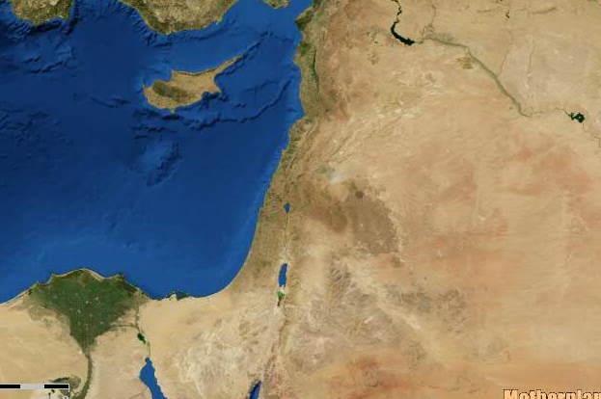
1 chronicles 18:1 – 21:30
Damascus
David's "Empire"
Jerusalem

Slide 3
1 chronicles 18:1 – 21:30
Cherethites ~ executioners
Pelethites ~ runners

Slide 4
1 chronicles 18:1 – 21:30
7000 ~ 2 Sam. 10:18 has 700

Slide 5
1 chronicles 18:1 – 21:30
A talent of gold would weigh between 75 and 90 lb.

Slide 6
1 chronicles 18:1 – 21:30
NASB ~ He brought out the people who were in it, and cut them with saws and with sharp instruments and with axes. And thus David did to all the cities of the sons of Ammon.
Also KJV
Following the LXX

Slide 7
1 chronicles 18:1 – 21:30
2 Sam. 24:1 ~ Again the anger of the Lord was aroused against Israel, and He moved David against them to say, “Go, number Israel and Judah.”

Slide 8
1 chronicles 18:1 – 21:30
Prov. 16:18 ~ Pride goes before destruction,
And a haughty spirit before a fall.
1 Cor. 10:12 ~ Therefore let him who thinks he stands take heed lest he fall.
Prov. 6:16-17a ~ ¹⁶ These six things the Lord hates,
Yes, seven are an abomination to Him:
^{17a} A proud look…

Slide 9
1 chronicles 18:1 – 21:30
The angel of the LORD ~ a theophany?

Slide 10
1 chronicles 18:1 – 21:30
David's Sacrifice on Mt. Moriah
(approx. 1000 BC)
1000 years
1000 years
Abraham's Sacrifice on Mt. Moriah
(approx. 2000 BC)
Jesus' Sacrifice
on Mt. Moriah
(approx. 33 AD)

Slide 11
1 chronicles 18:1 – 21:30
2 Sam. 24:24 ~ Then the king said to Araunah, “No, but I will surely buy it from you for a price; nor will I offer burnt offerings to the Lord my God with that which costs me nothing.” So David bought the threshing floor and the oxen for fifty shekels of silver.
Place ~ maqowm – field, area

